Slide 1
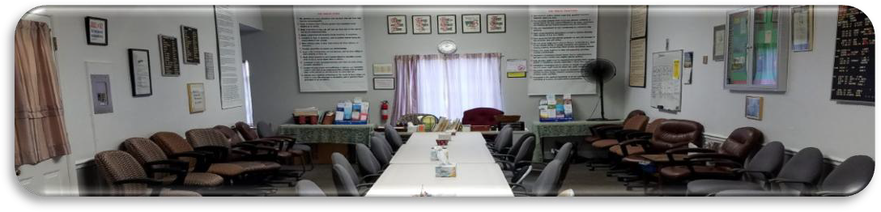

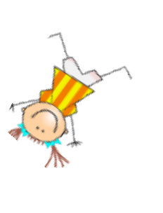
ANNIVERSARIES….Woo Hoo!
Barbara C., 38 years, Nov 13, celebrating Sun. November 15th at 9AM, Laurel Recovery Group ONLINE. ID 833 6915 6023, pw ODAT 2022

