Slide 1
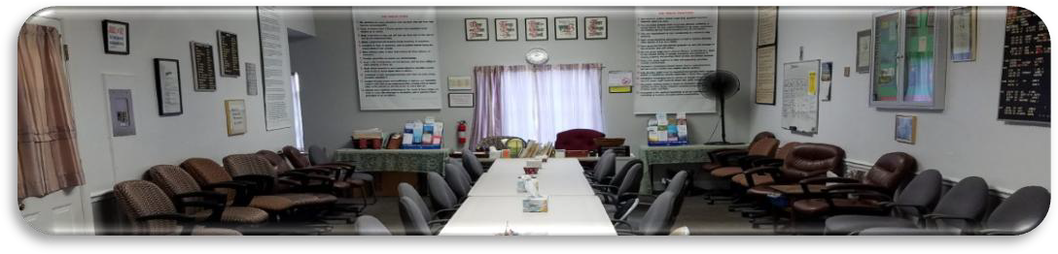

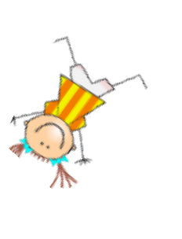
ANNIVERSARIES….Woo Hoo!
Marsha H., 35 years, celebrating Sun. July 19th at 9AM, Laurel Recovery Group ONLINE. ID 833 6915 6023, pw ODAT 2022

