Slide 1
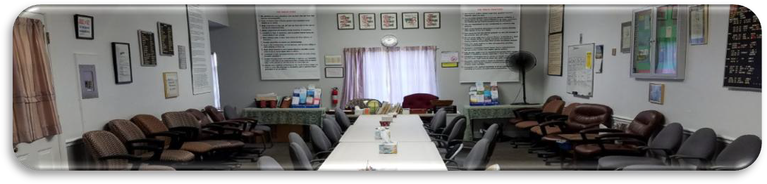

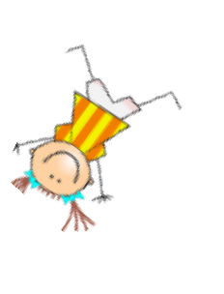
ANNIVERSARIES….Woo Hoo!
BRIAN D., 38 years, celebrating 8 PM Wednesday June 10th, Laurel Recovery @ Greenbelt Step Club in person —pizza and cake
KRISTEN, 3 years, 6/25, celebrating Sat. June 27th at 7AM, Captain’s Table ID 555 518 9178, pw 110516

