Slide 1
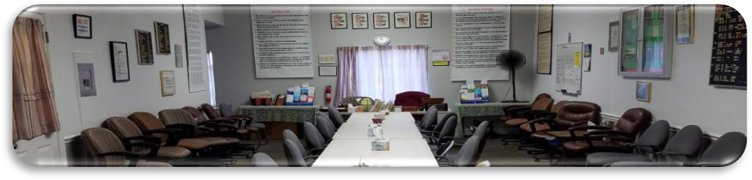

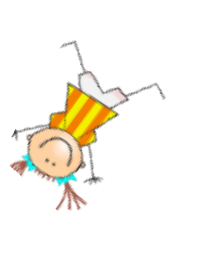
ANNIVERSARIES….Woo Hoo!
JAIME I., 6 years 5/8, celebrating 8:05PM Thursday May 14th, Laurel Recovery online, 833 6915 6023, pw ODAT2022
JOHN K., 43 years, celebrating 9AM Sunday May 17th, Laurel Recovery online, 833 6915 6023, pw ODAT2022
JOSH S., 2 years, celebrating 8 PM Wednesday May 27th, Laurel Recovery @ Greenbelt Step Club in person —pizza and cake

