Slide 1
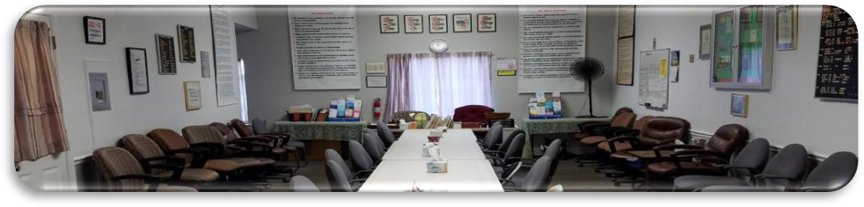

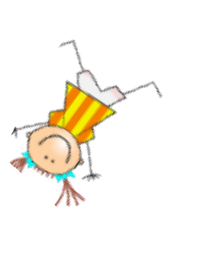
ANNIVERSARIES….Woo Hoo!
Margaret M., 12 years, (3/4) celebrating Friday March 6th, Laurel Recovery online 5:30 PM, ID 833 6915 6023, pw ODAT 2022
Jim S., 44 years, celebrating Sunday March 8, Laurel Recovery online 9AM, ID 833 6915 6023, pw ODAT 2022
Kevin C., 13 years, (3/17) celebrating Sunday March 22, Laurel Recovery online 9AM, ID 833 6915 6023, pw ODAT 2022
Loida, 14 years, celebrating Wednesday March 18th, Laurel Recovery @ Greenbelt Step Club in person, 8PM—pizza and cake
Edwin W., 35 years, Wednesday March 25th
Angela G., 6 years, Monday March 27^{th,} TBD

