Slide 1
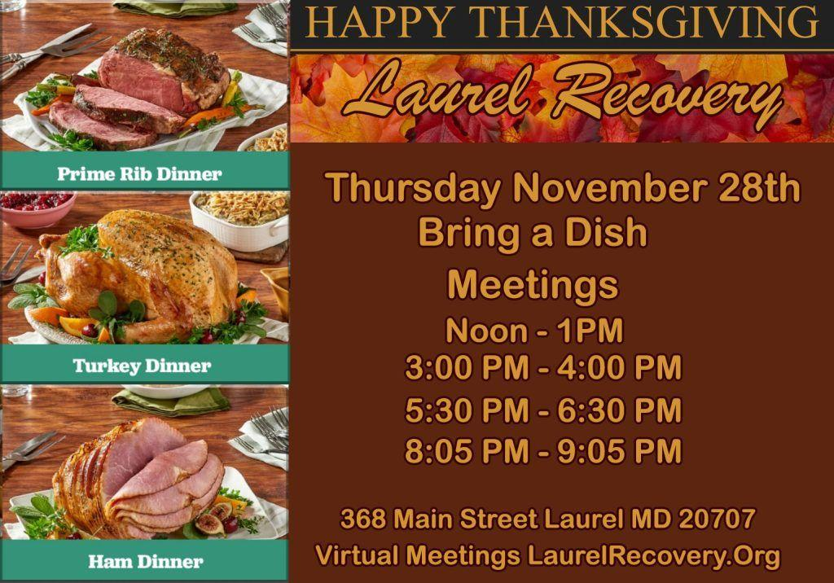
1
Announcements p. 1 of 3
THANKSGIVING DAY
Thursday November 28, 2024
In-Person Fellowship
From Noon to 9PM
Laurel Recovery Group
368 Main Street, Laurel 20707
LAUREL RECOVERY GROUP WILL MAINTAIN REGULAR 5:30 PM ONLINE THURSDAY MEETING SCHEDULE FOR THANKSGIVING DAY. INFORMATION ABOUT OTHER ONLINE THANKSGIVING DAY MEETINGS CAN BE FOUND AT https://aa-intergroup.org/group-events/thanksgiving-holiday-alcathon/

Slide 2
Announcements p.2 of 3
2 | Laurel Recovery Group Steering Committee Meeting SATURDAY DECEMBER 21st, 2024 At 10AM 368 Main Street, Laurel, MD 20707 All LRG members are welcome to attend. Secretaries are encouraged to attend. If you cannot attend and would like to have an item addressed, please send an email to Laurelrecoverygroup@gmail.com

Slide 3
Announcements p. 3 of 3
3 | SERVICE OPPORTUNITY ZOOM TECHS NEEDED. Need a PC or Mac, WILL TRAIN. Send email to laurelrecoveryrgroup @gmail.com, or notify the tech on duty.
4 | You will find resources, information about other events, and additional information in this meeting’s chat, and on our remarkable website laurelrecovery.org

