Slide 1

Announcements, p. 1of 2
1. | The next regular Laurel Recovery Group Service Committee meeting is scheduled for Saturday, October 17th at 10AM. Due to the temporary closure of LRG’s Main Street location, the meeting will be virtual. All Laurel Recovery members are welcome to attend, secretaries are encouraged to attend and have a vote. If you cannot attend and would like to have an item addressed, please send an email to laurelrecoverygroup@gmail.com.
2. | You will find resources, information about other events, fellowship events, service opportunities, etc. , and additional information in this meeting’s chat, on our remarkable website laurelrecovery.org, and in the Laurel Recovery Group WhatsApp.
3. | Effective September 28th, the LRG 7PM Monday night (temporarily online) Traditions meeting has closed due to lack of participation.

Slide 2
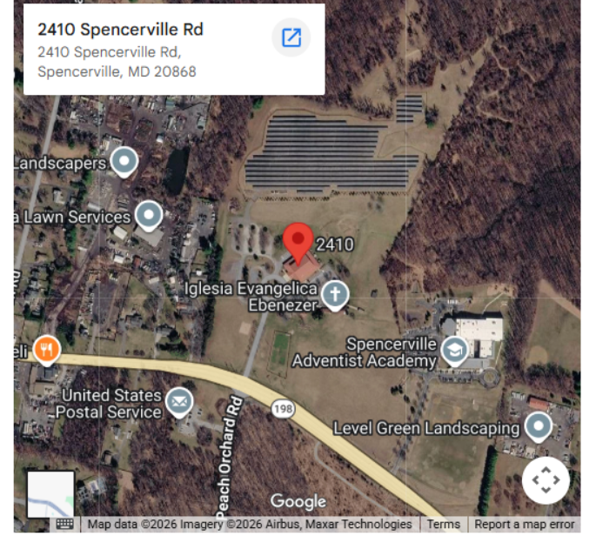
Announcements, p. 2of 2
4. | Effective October 3, 2026, Laurel Recovery Group’s Saturday 8:00 pm Experience, Strength and Hope Meeting is now Temporarily Hybrid. The in- person venue is Cedar Ridge, 2410 Spencerville Rd, Spencerville, MD 20868, and Zoom is ID 833 6915 6023, pw ODAT2022. the group will be reading from Experience, Strength and Hope, then open for discussion and sharing.

